Slide 1





MySQL and PHP Advanced
Table Relationships and Customization, Wildcards, Transactions
MySQL & PHP
Advanced
SoftUni Team
Technical Trainers
Software University
http://softuni.bg

Slide 2

Table of Contents
Table Relationships
Table Customization
Wildcards
Transactions

Slide 3
Questions
sli.do #PHPFUND

Slide 4
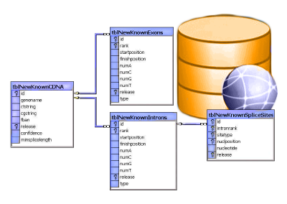
Table Relationships

Slide 5
Why Split Related Data?
Empty records
First | Last | Registered | Email
David | Rivers | 05/02/2016 | drivers@mail.cx
Sarah | Thorne | 07/17/2016 | sarah@mail.cx
Michael | Walters | 11/23/2015 | walters_michael@mail.cx
Email2
david@homedomain.cx
NULL
NULL
Redundant information
OrderID | Date | Customer | Product | S/N | Price
00315 | 07/16/2016 | David Rivers | Oil Pump | OP147-0623 | 69.90
00315 | 07/16/2016 | David Rivers | Accessory Belt | AB544-1648 | 149.99
00316 | 07/17/2016 | Sarah Thorne | Wiper Fluid | WF000-0001 | 99.90
00317 | 07/18/2016 | Michael Walters | Oil Pump | OP147-0623 | 69.90

Slide 6
Related Tables
We split the data and introduce relationships between the tables to avoid repeating information
The connection is established via a Foreign Key in one table pointing to the Primary Key in another
UserID | First | Last | Registered
203 | David | Rivers | 05/02/2016
204 | Sarah | Thorne | 07/17/2016
205 | Michael | Walters | 11/23/2015
UserID | Email
203 | drivers@mail.cx
204 | sarah@mail.cx
205 | walters_michael@mail.cx
203 | david@homedomain.cx
Primary Key
Foreign Key

Slide 7
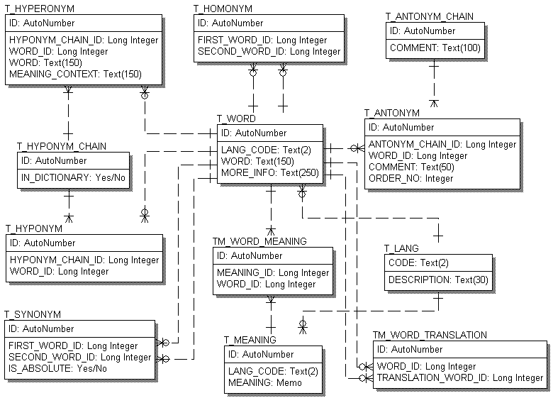
E/R Diagrams

Slide 8
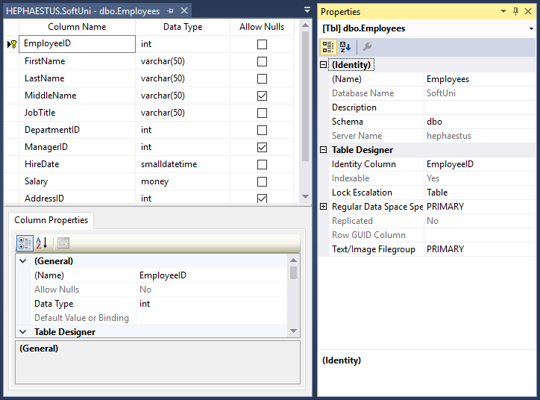
Altering Tables
Changing Table Properties After Creation

Slide 9
Altering Tables Using SQL
A table can be changed using the keywords ALTER TABLE
Add new column
ALTER TABLE Employees
Table name
ALTER TABLE Employees
ADD Salary INT
Column name
Data type

Slide 10
Altering Tables Using SQL (2)
Delete existing column
Modify data type of existing column
Column name
ALTER TABLE People
DROP COLUMN FullName
ALTER TABLE People CHANGE Email Email varchar(100)
Old column name
New column name
New data type

Slide 11
Altering Tables Using SQL (3)
Add primary key to existing column
Add unique constraint
Constraint name
ALTER TABLE People ADD CONSTRAINT PK_Id
PRIMARY KEY (Id)
Column name
(more than one for composite key)
Constraint name
ALTER TABLE People ADD CONSTRAINT uq_Email
UNIQUE (Email)
Columns name(s)

Slide 12
Altering Tables Using SQL (4)
To remove a constraining rule from a column
This includes primary keys, value constraints and unique fields
To remove default value
Table name
ALTER TABLE Employess DROP CONSTRAINT pk_Id
Constraint name
Table name
ALTER TABLE Employess ALTER Clients
DROP DEFAULT
Columns name

Slide 13
Altering Tables Using SQL (5)
Add foreign key to existing tables
Constraint name
ALTER TABLE Employees
ADD CONSTRAINT fk_employees_departments
FOREIGN KEY (department_id)
REFERENCES Departments (department_id)
ON DELETE CASCADE ON UPDATE CASCADE
PRIMARY KEY in the reference table
Propagate changes to foreign table

Slide 14
Programmability
Begin
?
?
Customizing Database Behavior

Slide 15
Indices
Indices make data lookup faster
Clustered – bound to the primary key, physically sorts data
Non-Clustered – can be any field, references the clustered index
Structured as an ordered tree
Keys
Index
0-99
100-199
200-299
Range 1
Range 2
Range 3
Data
Links
☰
☰
☰
☰
☰
☰
☰
☰
☰
☰
☰
☰
☰
☰

Slide 16
Views
Views are prepared queries for displaying sections of our data
Evaluated at run time – they do not increase performance
CREATE VIEW v_EmployeeNames AS
SELECT `EmployeeID`
,`FirstName`
,`LastName`
FROM `Employees`
SELECT * FROM v_EmployeeNames
Notes:
Views are objects that show portion of the data. For example, we may show only 3 column even though the table has 9.

Slide 17
Procedures, Functions and Triggers
A database can further be customized with reusable code
Procedures – carry out a predetermined action
E.g. calculate and store the weekly revenue based on recorded sales in the database
Functions – receive parameters and return a result
E.g. get the age of a person using their birthdate and current date
Triggers – watch for activity in the database and react to it
E.g. when a record is deleted, write it to an archive

Slide 18
Procedures
DELIMITER //
CREATE PROCEDURE GetAllEmployees()
BEGIN
SELECT * FROM Employees;
END //
DELIMITER ;
Change default delimiter
Revert to default delimiter
Execute the new procedure
CALL GetAllEmployees

Slide 19
Call Procedures with PHP
try {
$db = new PDO('mysql:host=localhost;dbname=softuni', $user, $pass);
$result = $db->query('CALL GetAllEmployees', PDO::FETCH_ASSOC);
foreach ($result as $row) {
print_r($row);
}
$result = null;
$db = null;
} catch (PDOException $e) {
print "Error!: " . $e->getMessage() . "<br/>";
}
query method does not escape data, but safe in this case
Always close the connection

Slide 20
Functions
DELIMITER //
CREATE FUNCTION GETFULLNAME(fname CHAR(250), lname CHAR(250))
RETURNS CHAR(250)
BEGIN
DECLARE fullname CHAR(250);
SET fullname=CONCAT(fname,' ',lname);
RETURN fullname;
END //
DELIMITER ;
SELECT GETFULLNAME ("Dimitar", "Petkov") AS MyName;
Notes:
Functions resemble return methods in programming. They execute some logic and return a result of some data type.

Slide 21
Call Functions with PHP
try {
$db = new PDO('mysql:host=localhost;dbname=softuni', $user, $pass);
$stmt = $db->prepare("SELECT GETFULLNAME (?, ?) AS MyName ");
if ($stmt->execute(['Dimitar', 'Petkov'])) {
while ($row = $stmt->fetch(PDO::FETCH_ASSOC)) {
print_r($row);
}
}
$stmt = null;
$db = null;
} catch (PDOException $e) {
print "Error!: " . $e->getMessage() . "<br/>";
}
Close the connection

Slide 22
Triggers
Let's create a table to track changes of Employees table
CREATE TABLE EmployeesAudit (
id INT AUTO_INCREMENT PRIMARY KEY,
employeeNumber INT NOT NULL,
lastname VARCHAR(50) NOT NULL,
changedat DATETIME DEFAULT NULL,
action VARCHAR(50) DEFAULT NULL
);

Slide 23
Triggers(2)
DELIMITER //
CREATE TRIGGER before_employee_update
BEFORE UPDATE ON Employees
FOR EACH ROW
BEGIN
INSERT INTO EmployeesAudit
SET action = 'update',
employeeNumber = OLD.EmployeeID,
lastname = OLD.LastName,
changedat = NOW();
END //
DELIMITER ;
OLD to access columns of the row affected by the trigger
Notes:
Triggers are procedures which are bound to a table. They track if an Insert, Update or Delete statements is executed and then they trigger some logic. For example, if you delete a record in a table the trigger will catch the event and may log the deleted record in another table.

Slide 24

Wildcards
Selecting results by partial match

Slide 25
Using WHERE … LIKE
Wildcards are used with WHERE to filter for partial match
Similar to Regular Expressions
Example: Find all employees who's first name starts with "Ro"
SELECT ID, FirstName, LastName
FROM Employees
WHERE FirstName LIKE 'Ro%'
Wildcard symbol

Slide 26
Wildcard Characters
Supported characters include
ESCAPE – specify another escape character, the default is "\"
% --any string, including zero-length
_ --any single character
[…] --any character within range
[^…] --any character not in the range
SELECT ID, Name
FROM Tracks
WHERE Name LIKE '%max!%' ESCAPE '!'

Slide 27

Transactions
Following the ACID properties

Slide 28
Running Transactions
A transaction is a sequence of operations performed as a single logical unit of work
START TRANSACTION
INSERT INTO Projects(Name, StartDate)
VALUES('Introduction to MySQL', '1/1/2006')
COMMIT or ROLLBACK
Mark start of transaction
Confirm or cancel the changes

Slide 29
Transactions with PHP
Init connection
try {
$db->beginTransaction();
$stmt = $db->prepare("INSERT INTO Users (fname, lname) VALUES (?, ?)");
$stmt->bindParam(1, $fname);
$stmt->bindParam(2, $lname);
$fname = 'Joro';
$lname = 'Petrov';
$stmt->execute();
$db->commit();
} catch (PDOException $e) {
$db->rollBack();
print "Error!: " . $e->getMessage() . "<br/>";
}
Never forget to close the connection

Slide 30

Summary
Table relations reduce repetition and complexity
Using Wildcards we can obtain results by partial string matches
We can use stored procedures, functions and triggers
With Transactions we satisfy the ACID properties

Slide 31








MySQL and PHP Basics
https://softuni.bg/courses/php-basics/

Slide 32

License
This course (slides, examples, demos, videos, homework, etc.) is licensed under the "Creative Commons Attribution-NonCommercial-ShareAlike 4.0 International" license
Attribution: this work may contain portions from
"PHP Manual" by The PHP Group under CC-BY license
"PHP and MySQL Web Development" course by Telerik Academy under CC-BY-NC-SA license

Slide 33




Free Trainings @ Software University
Software University Foundation – softuni.org
Software University – High-Quality Education, Profession and Job for Software Developers
softuni.bg
Software University @ Facebook
facebook.com/SoftwareUniversity
Software University Forums
forum.softuni.bg

